Slide 1
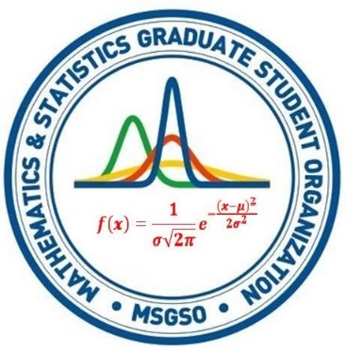
Letting the students know about the pros and cons of step by step online calculators
Dr. Majid Bani-Yaghoub

Slide 2
Part I
Issues with online assignments

Slide 3
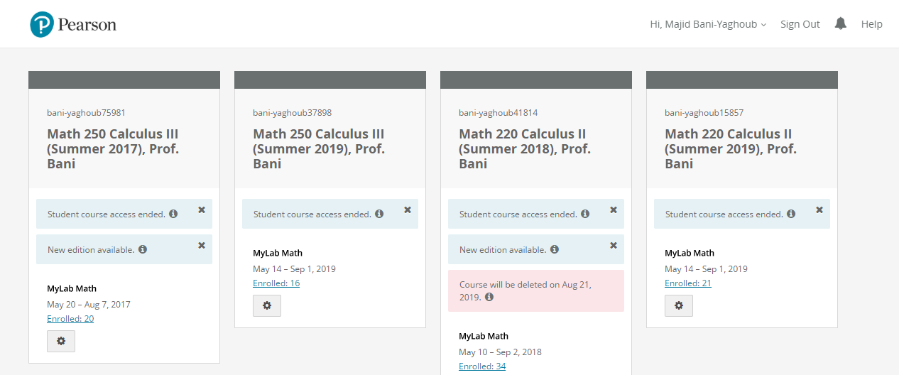
Pearson Courses: Summer 2017-2019

Slide 4
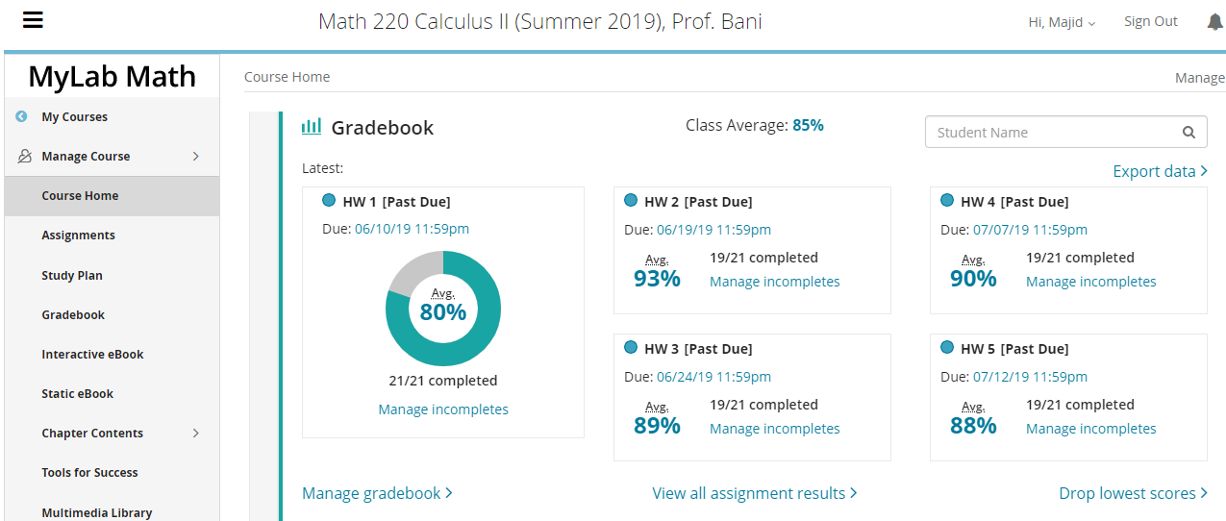
Calculus II Summer 2019

Slide 5
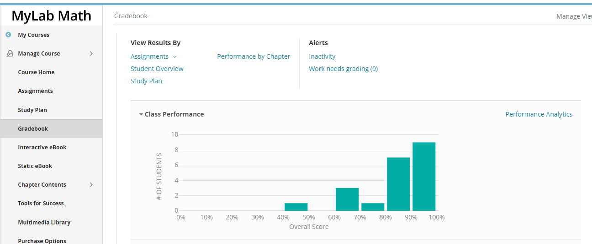
Class Performance

Slide 6
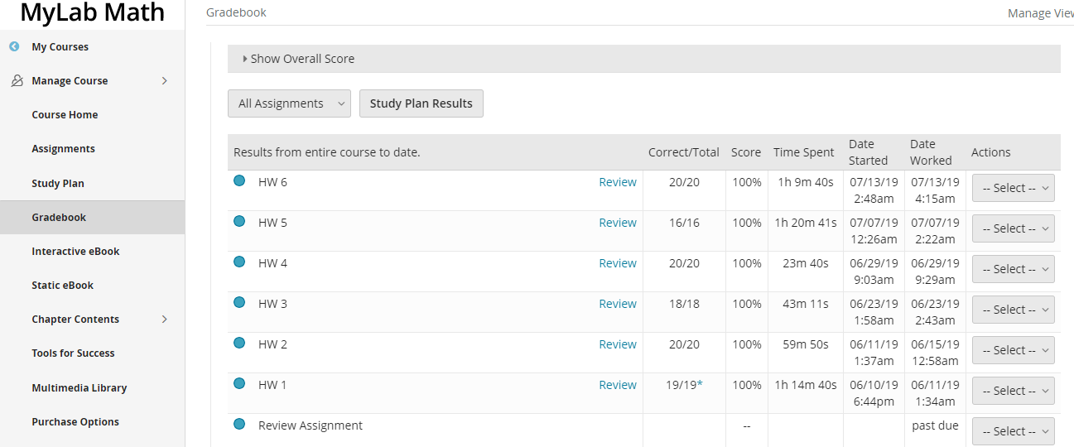
Time spent on each homework

Slide 7
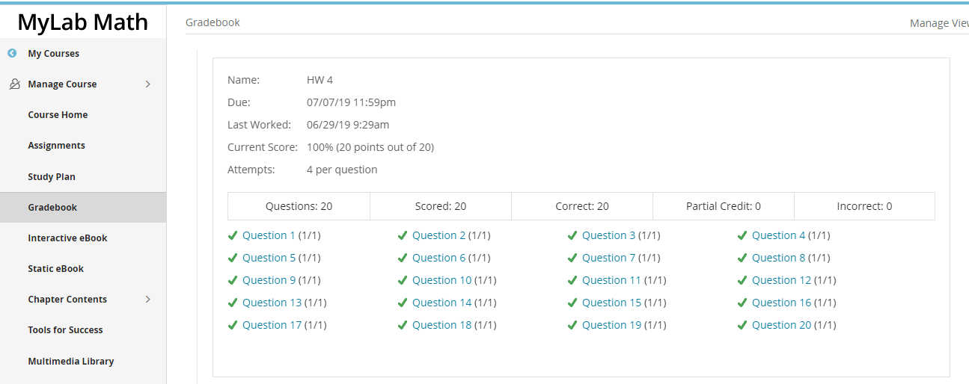
Review of Homework 4

Slide 8
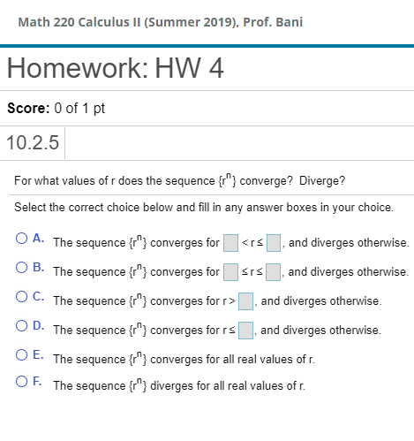
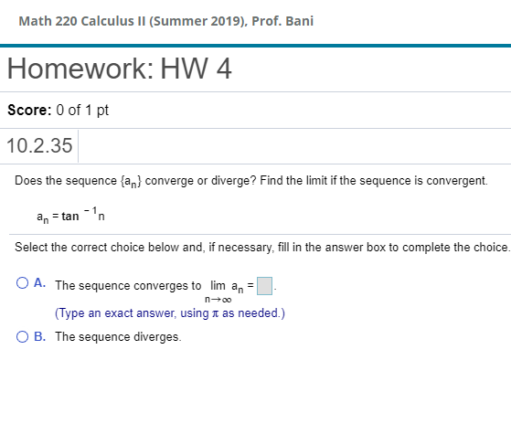
The student asked her sister to solve the problems! The student got a C-

Slide 9
Pearson Courses: Summer 2017-2019

Slide 10
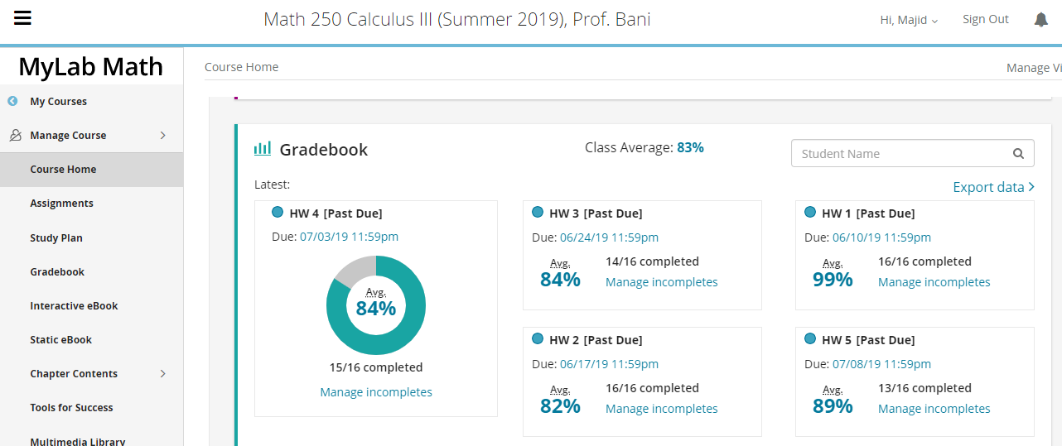
Calculus III, Summer 2019

Slide 11
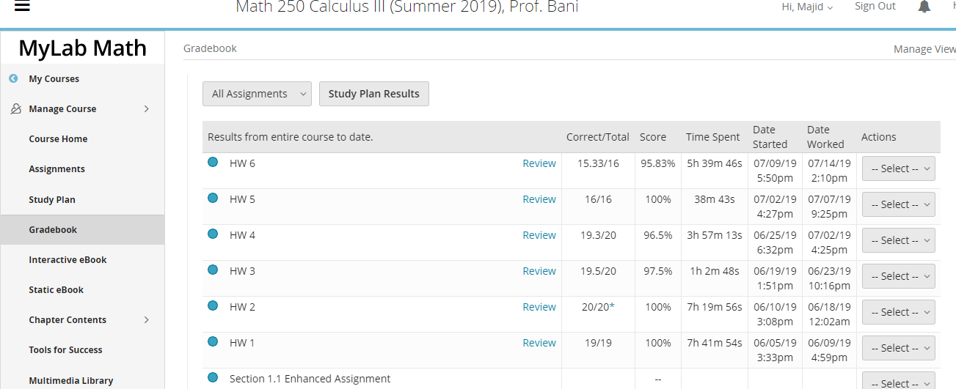
Time spent on each homework: The student was signed in, but doing other things

Slide 12
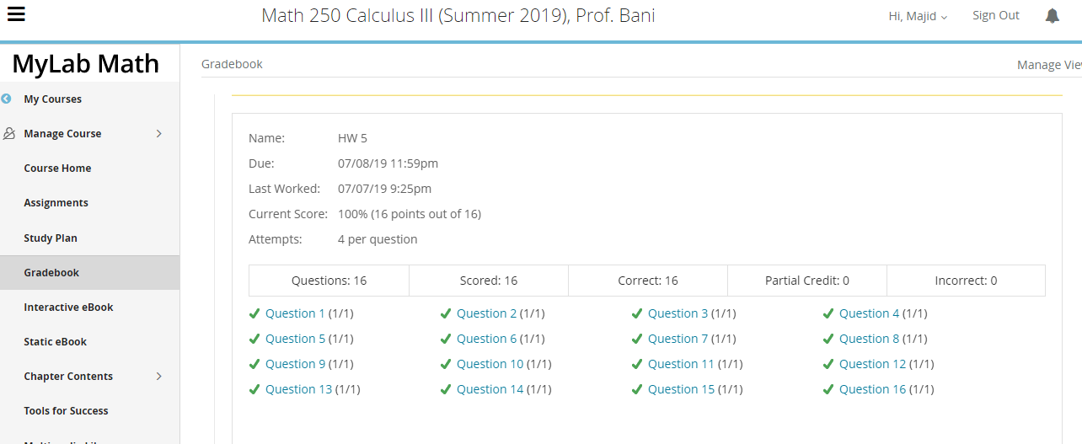
Analysis of HW 5: 16 problems solved in 38 min

Slide 13
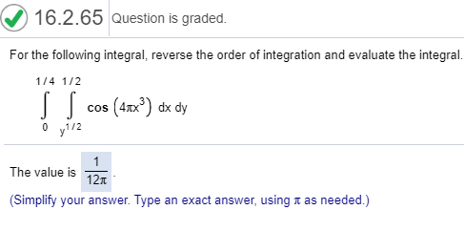
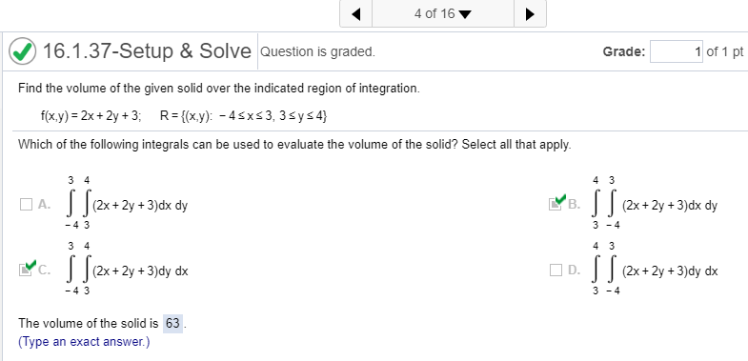
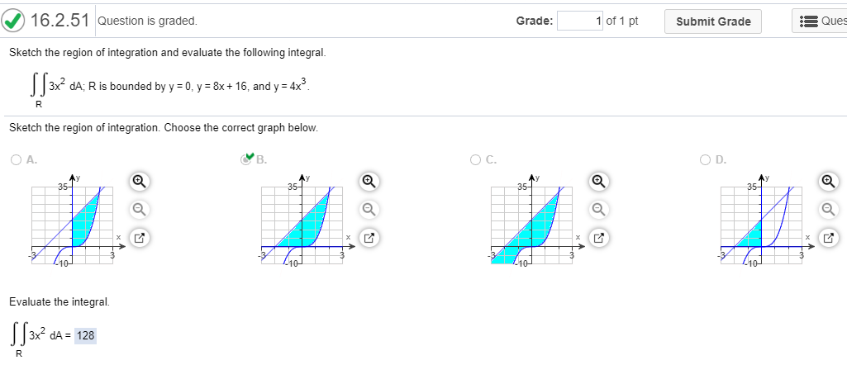
The student got help from a tutor! Final Grade C

Slide 14
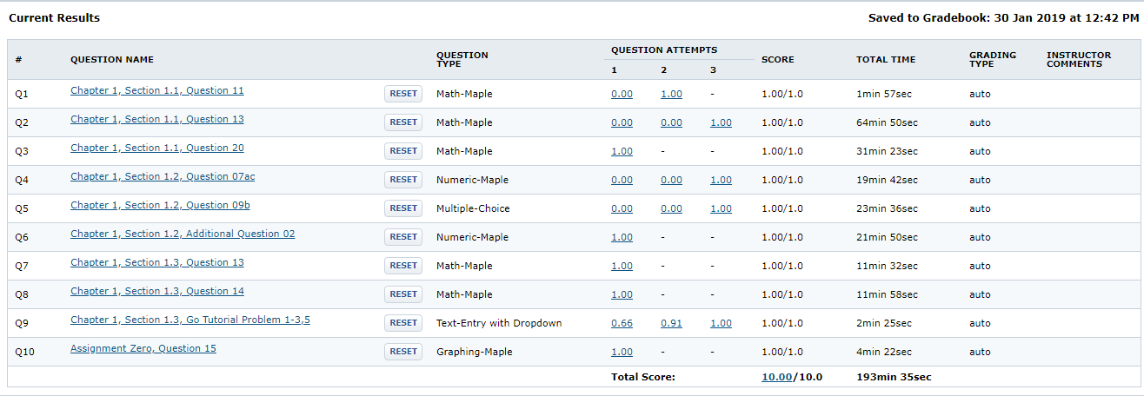
Example of WileyPlus

Slide 15
Recommendations
All online assignment and quizzes should worth less than 10% of final grade.
Let the students know about the consequences of cheating.
Active learning: Don’t lecture continuously more than 20 minutes.
Projects, Group works, Desmos, History and Applications of Mathematics are key elements of student engagement

Slide 16
Part II
Advanced Cheating

Slide 17
Step 1 Make Arrangements

Slide 18
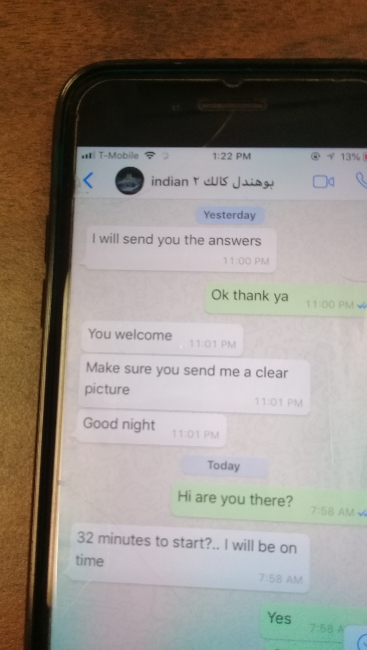
Step 1 Make Arrangements

Slide 19
Step 2: Take pictures from the exam

Slide 20
Step 3. Enter the chat room Make sure your cell phone has enough battery!

Slide 21
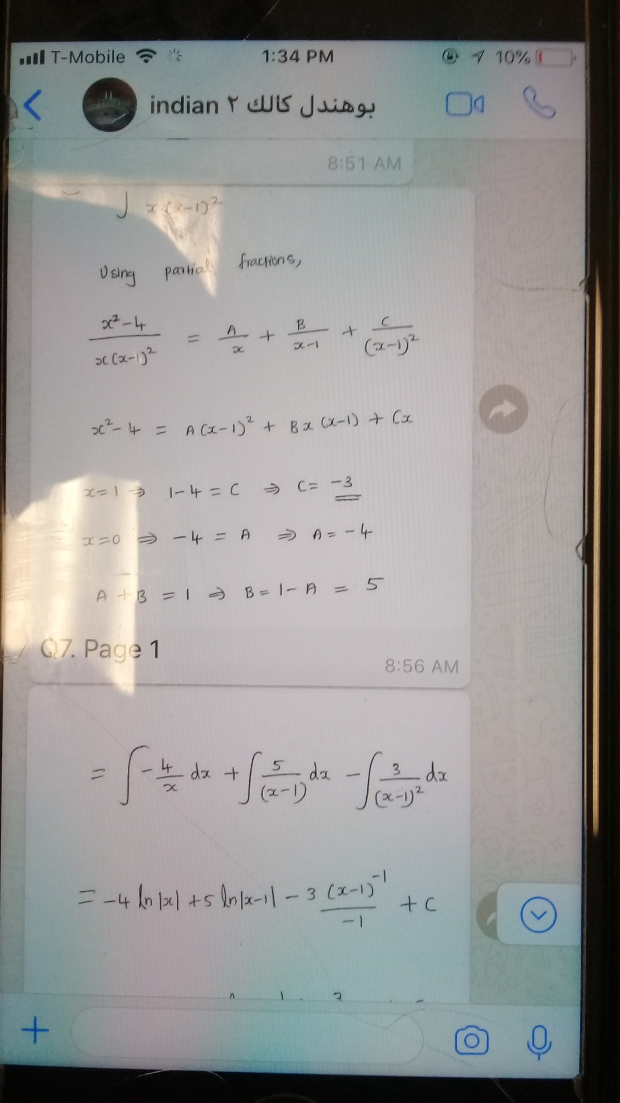
Step 4. Be careful with the instructor, He is very tricky.

Slide 22
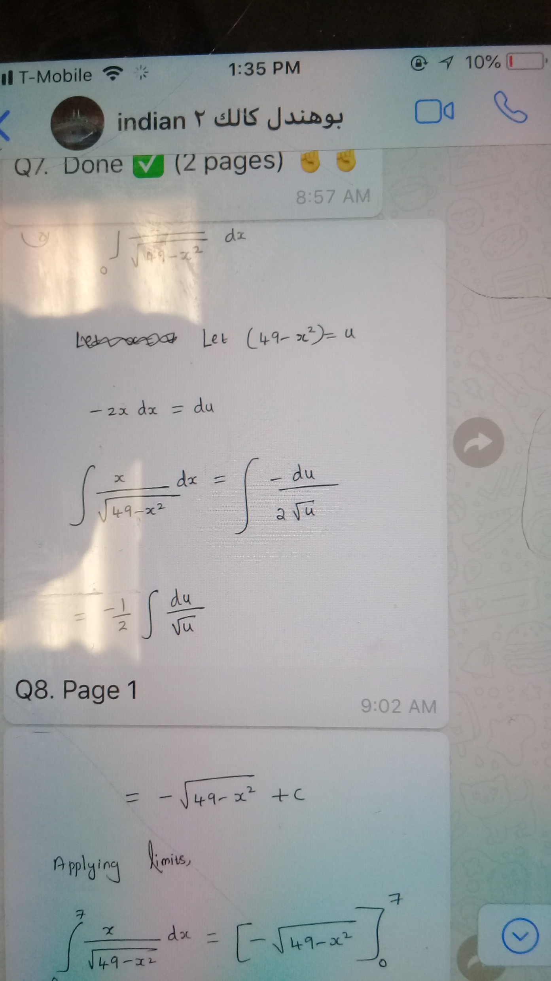
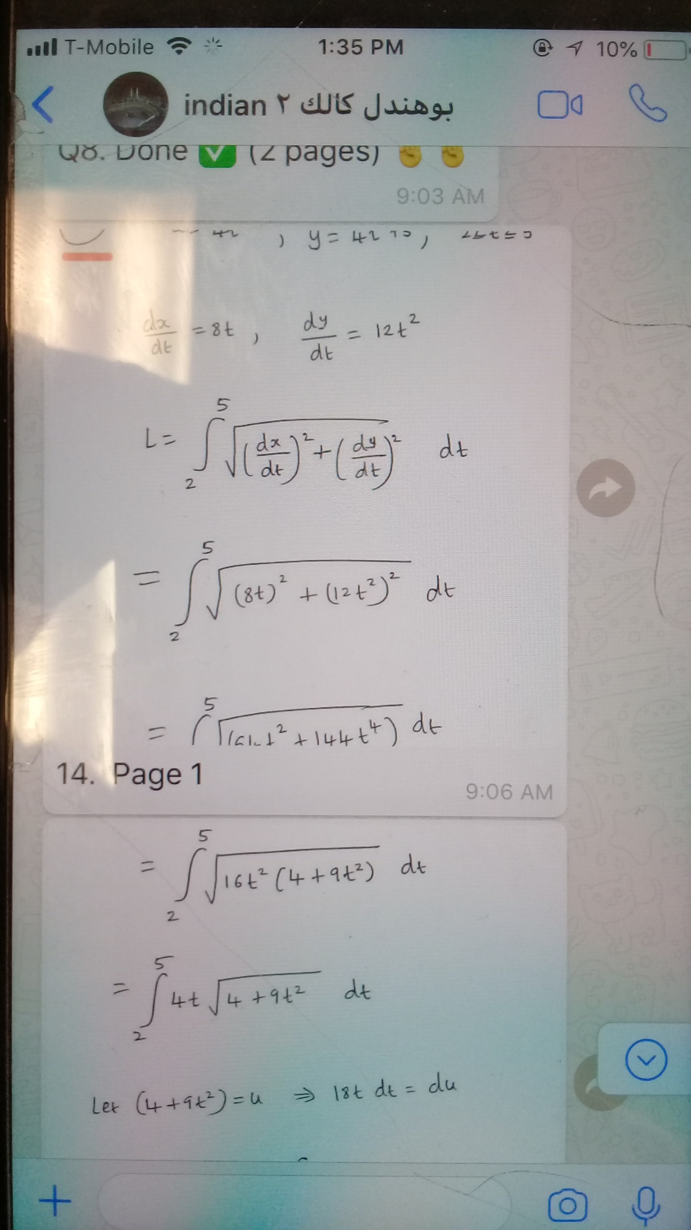
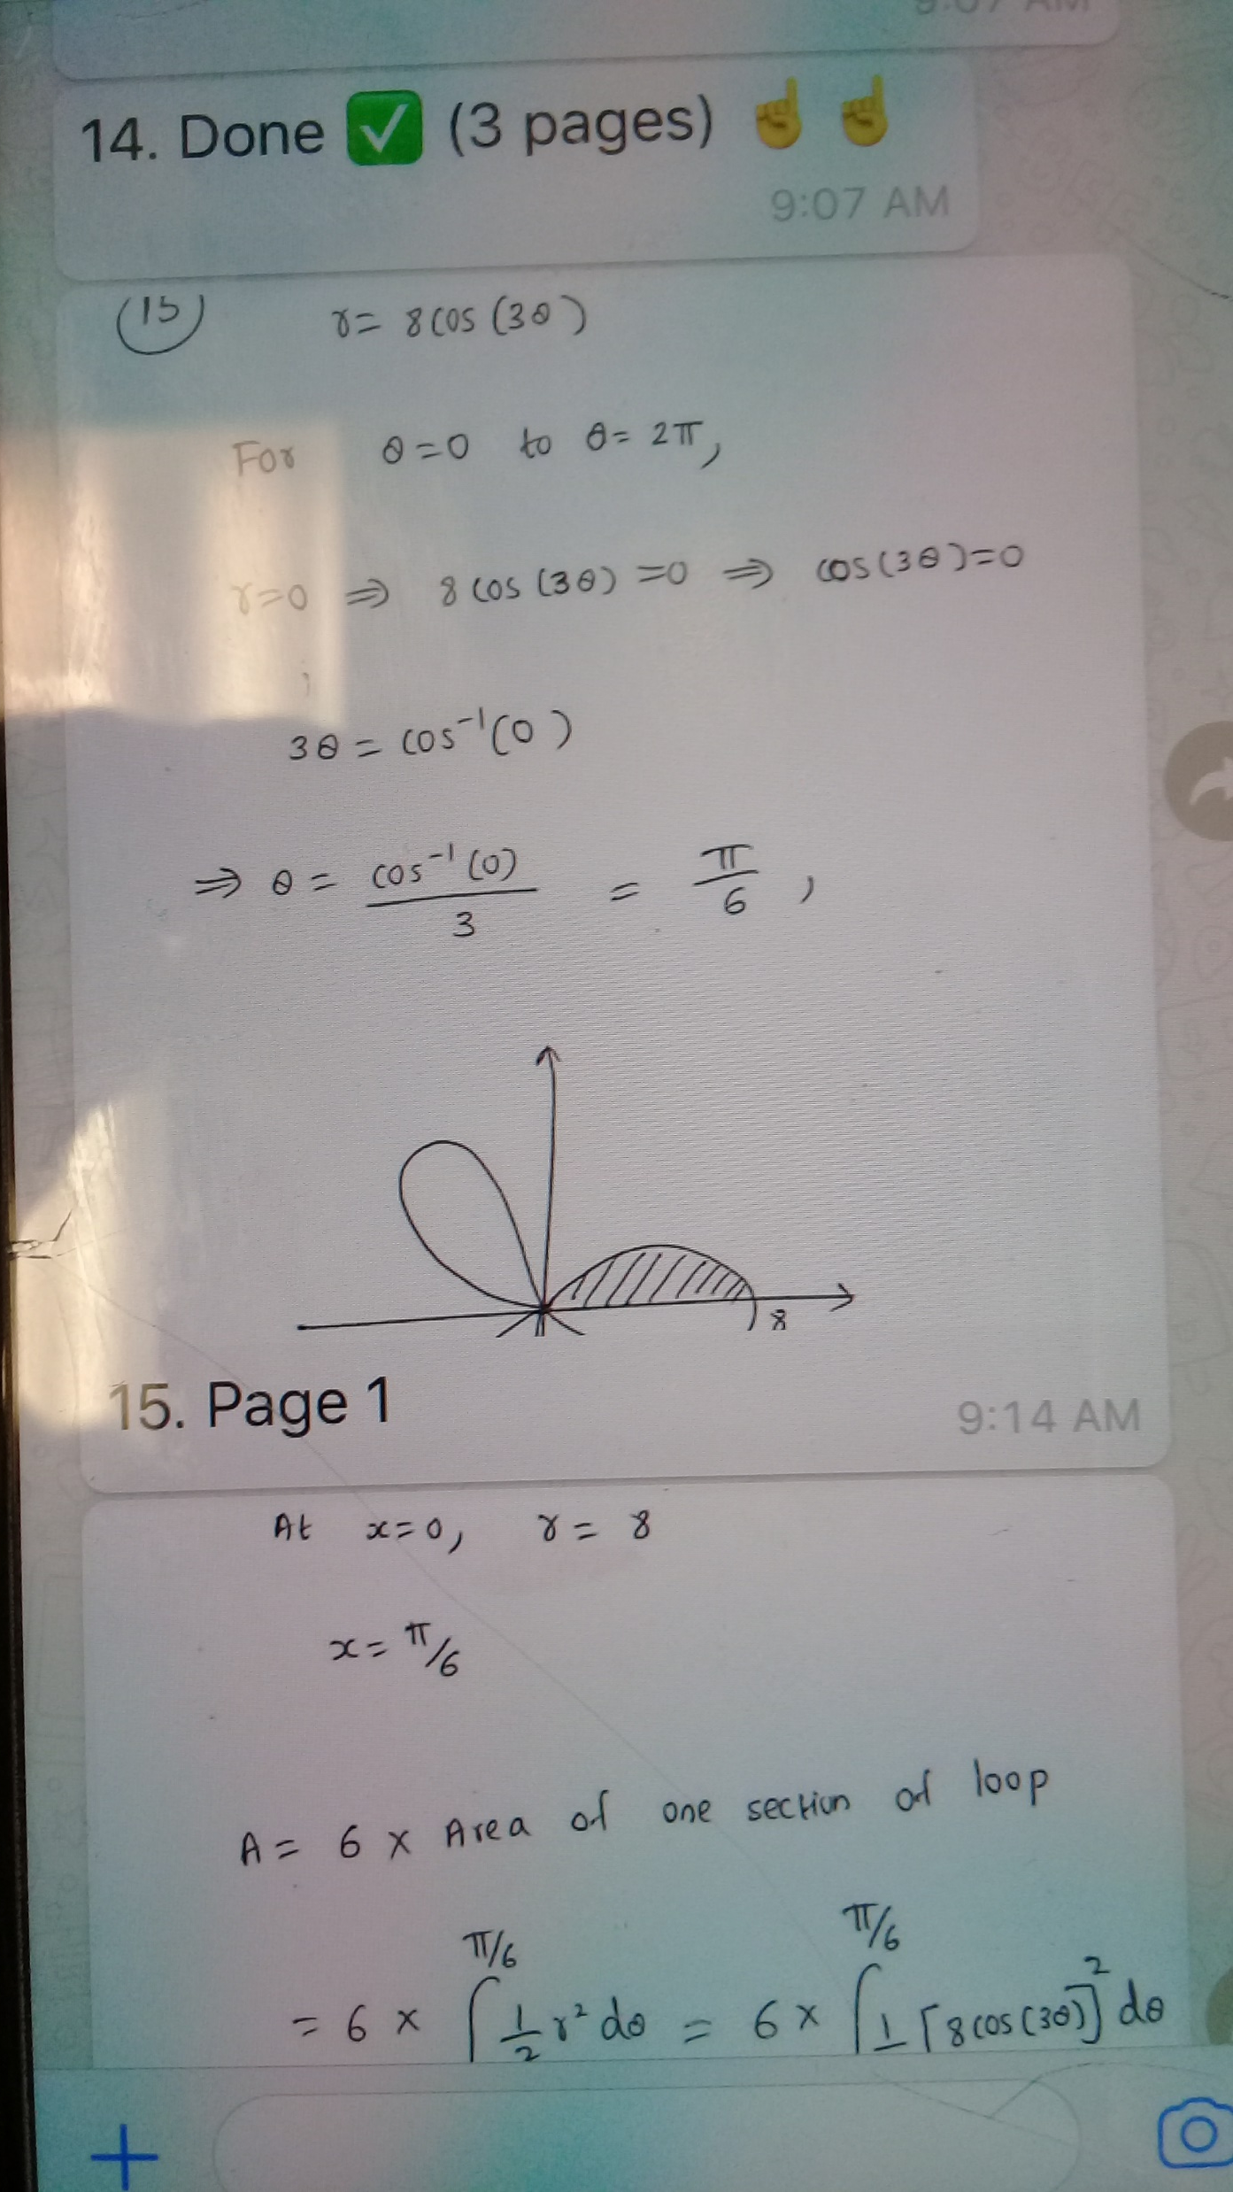

Slide 23
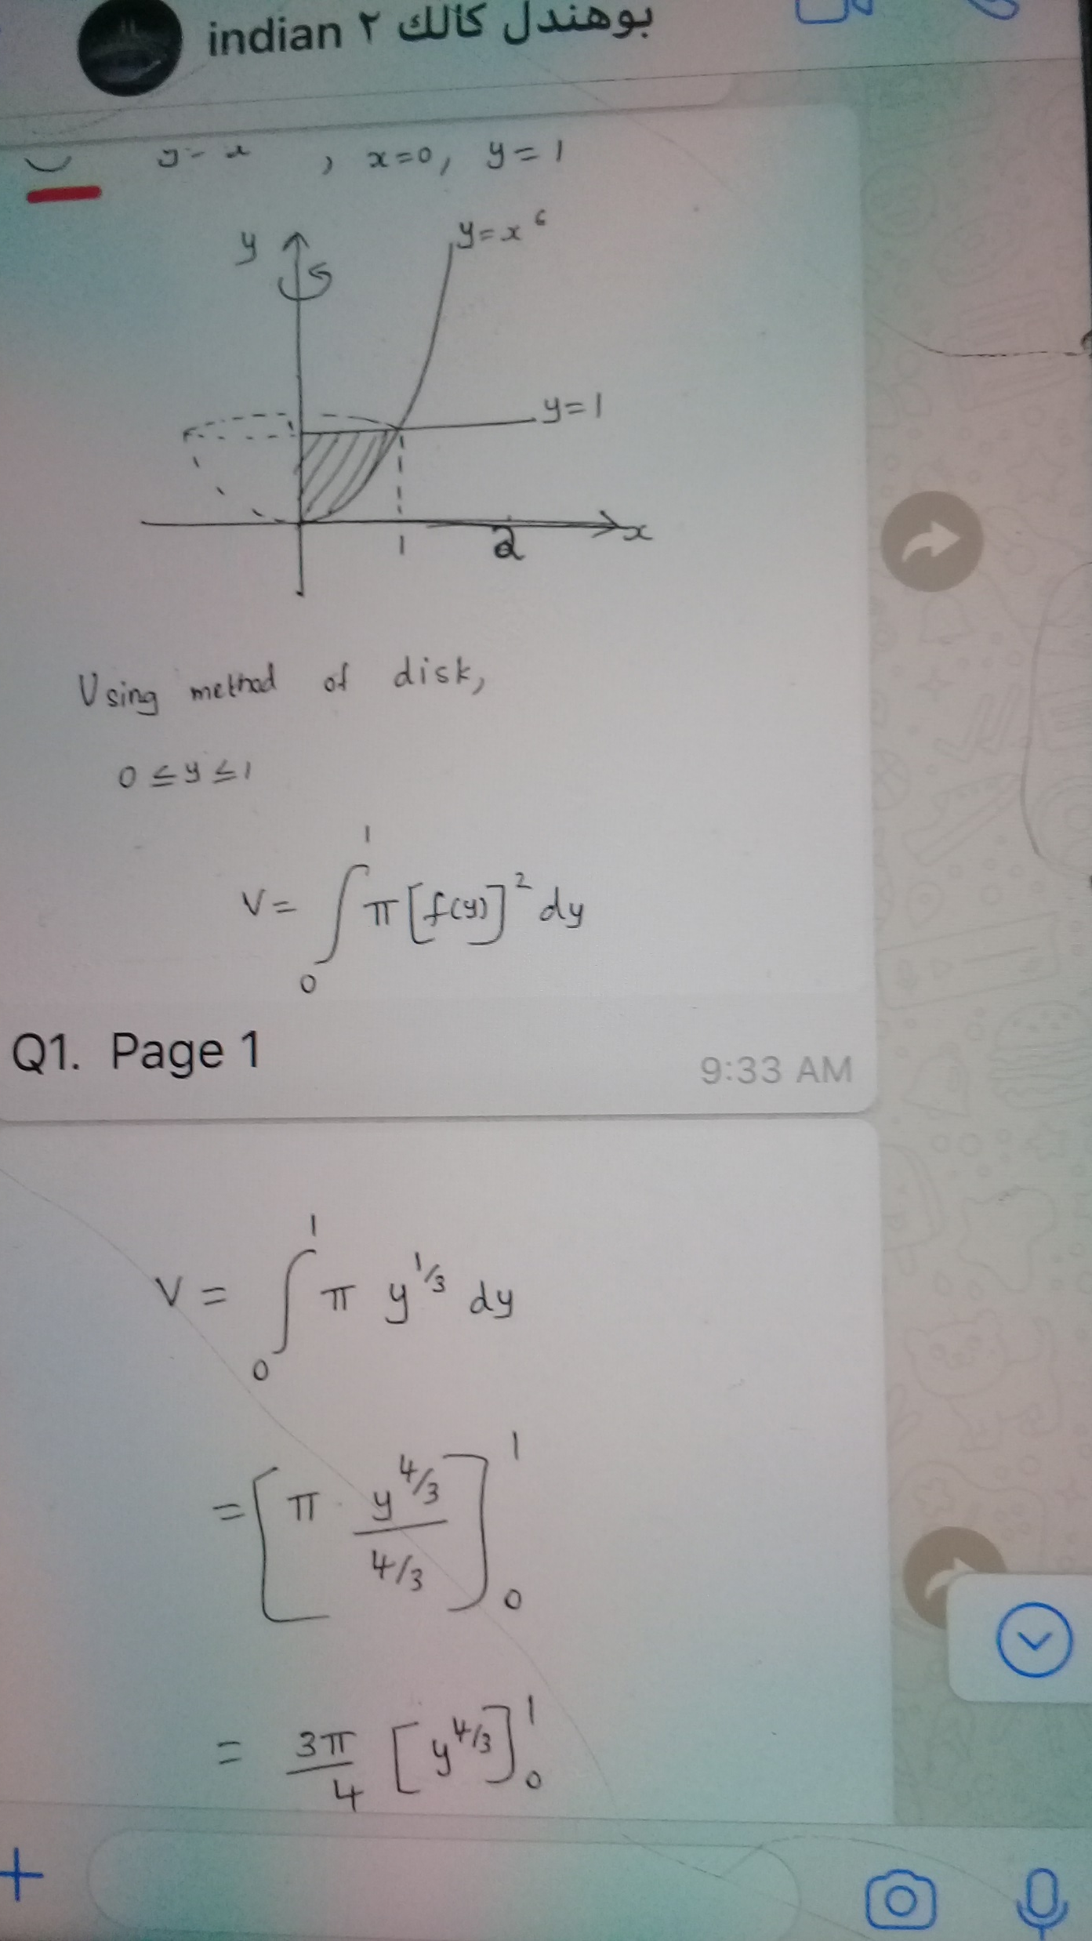
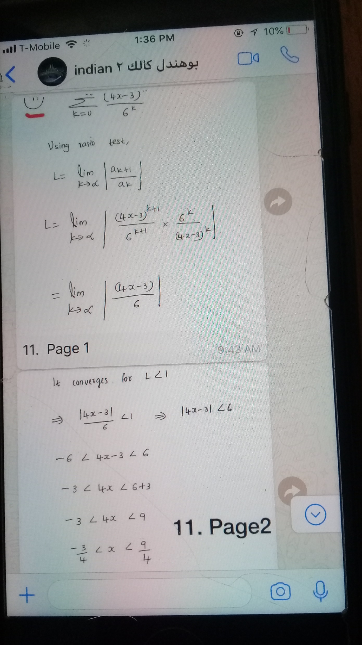

Slide 24
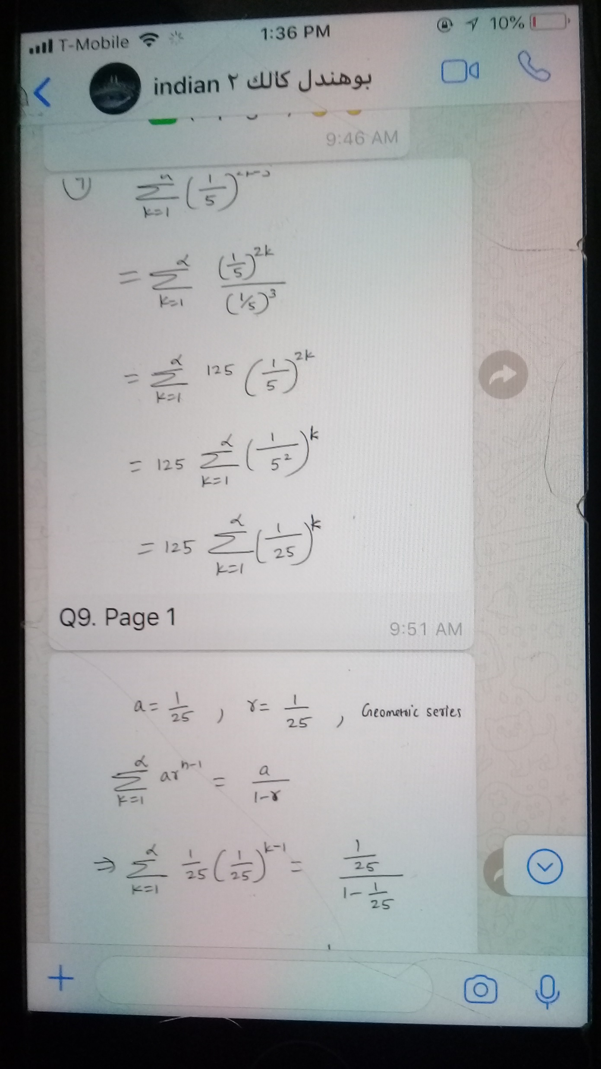
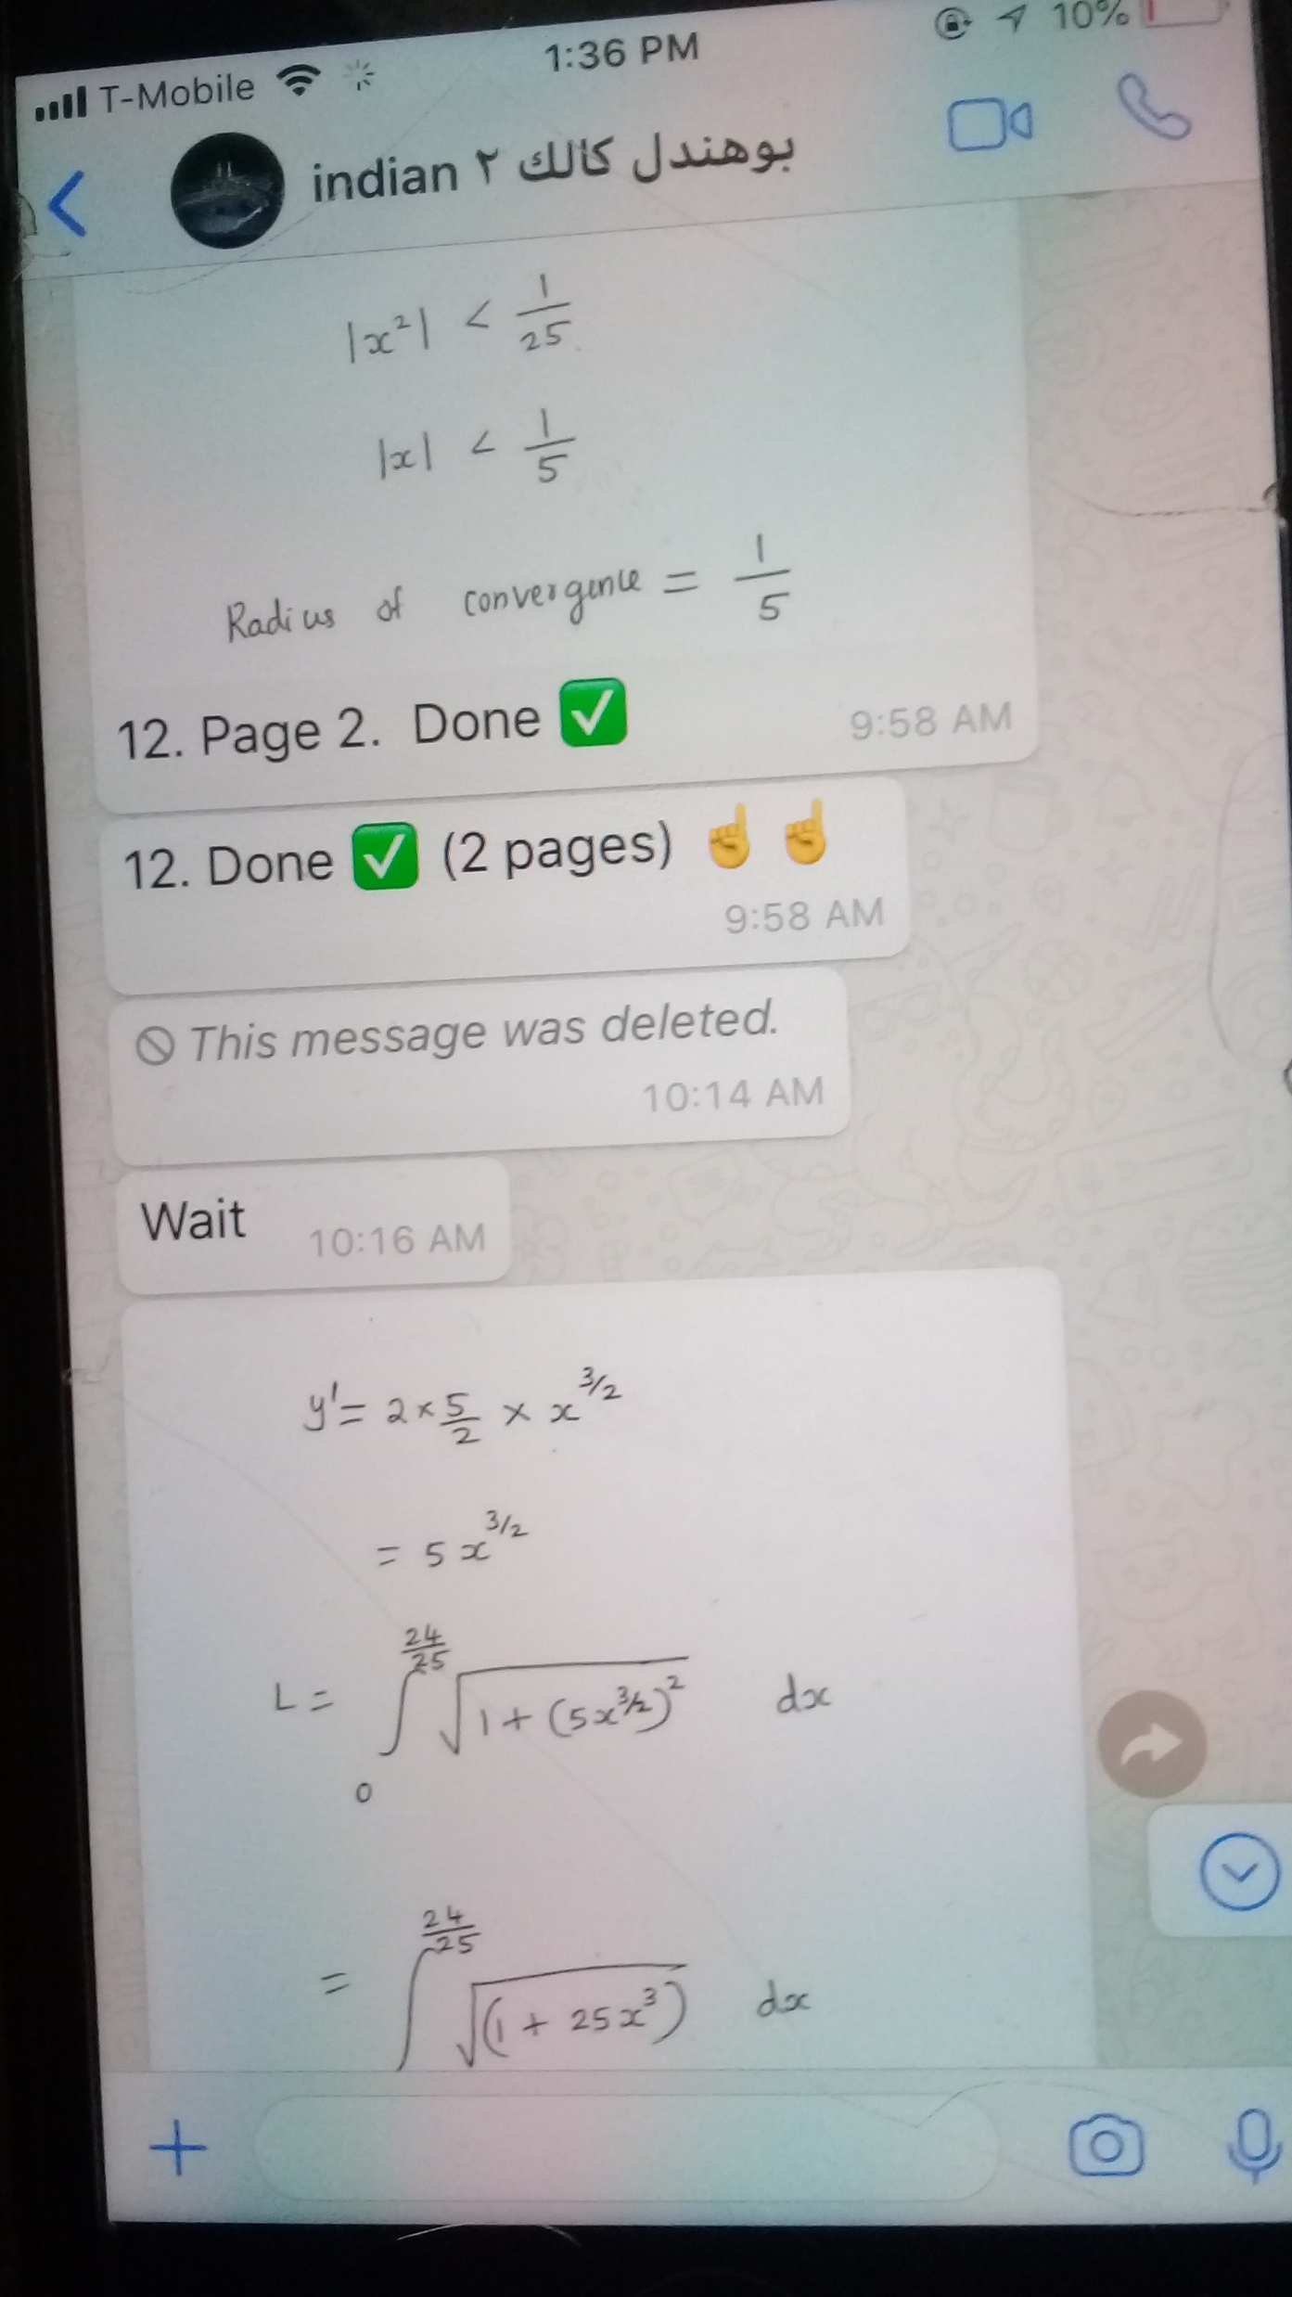
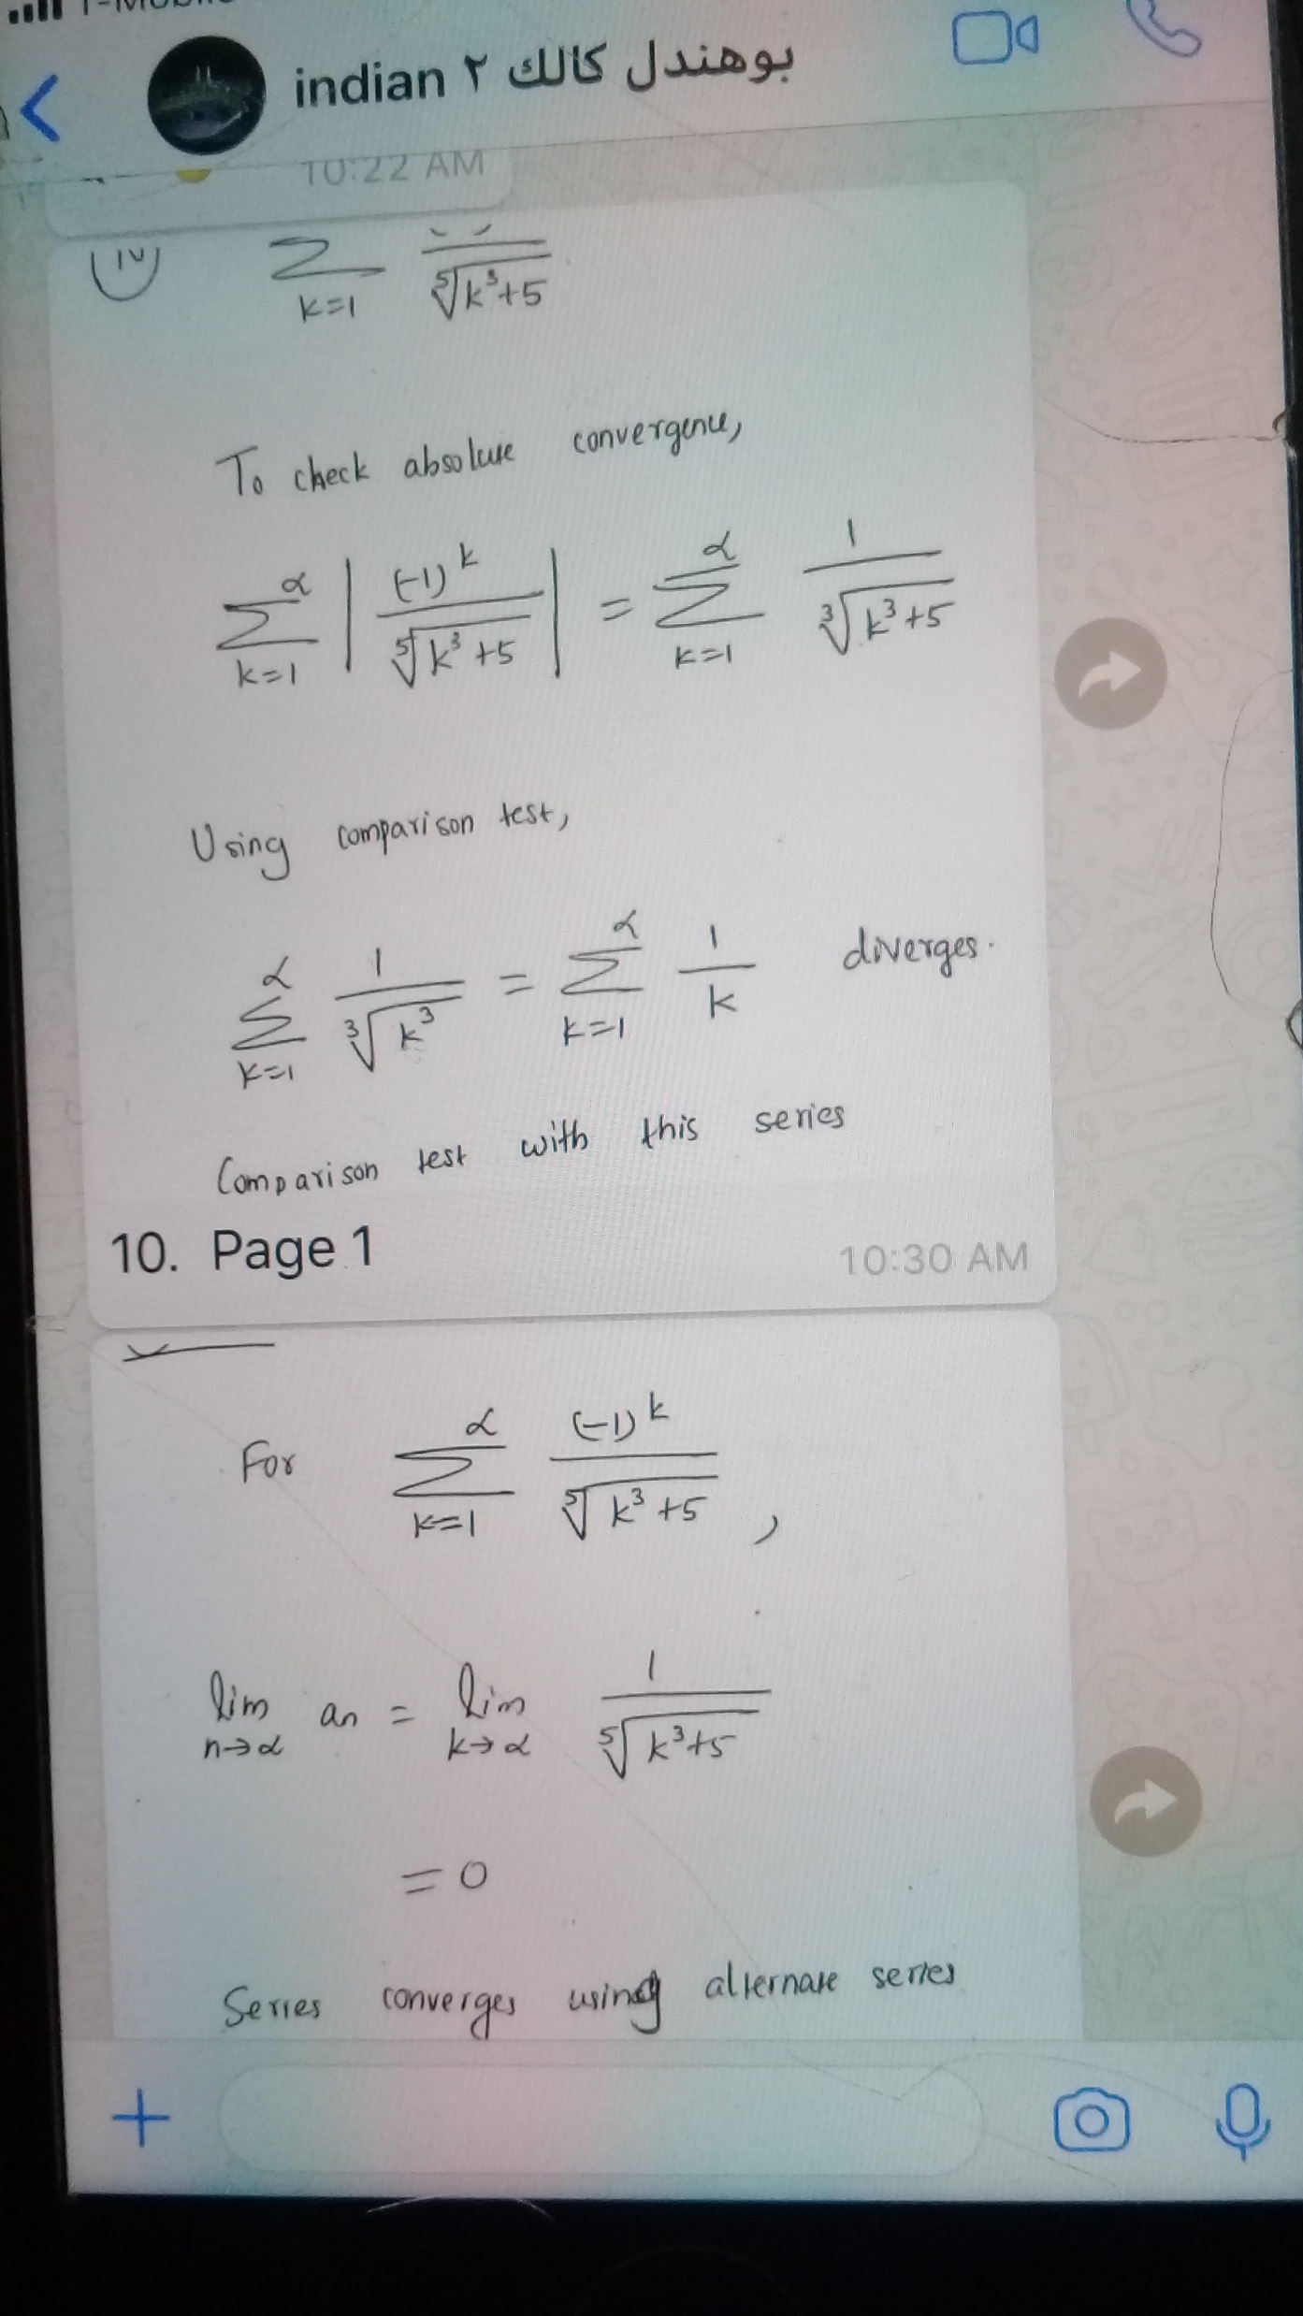

Slide 25
Part III
Issues with traditional assignments

Slide 26
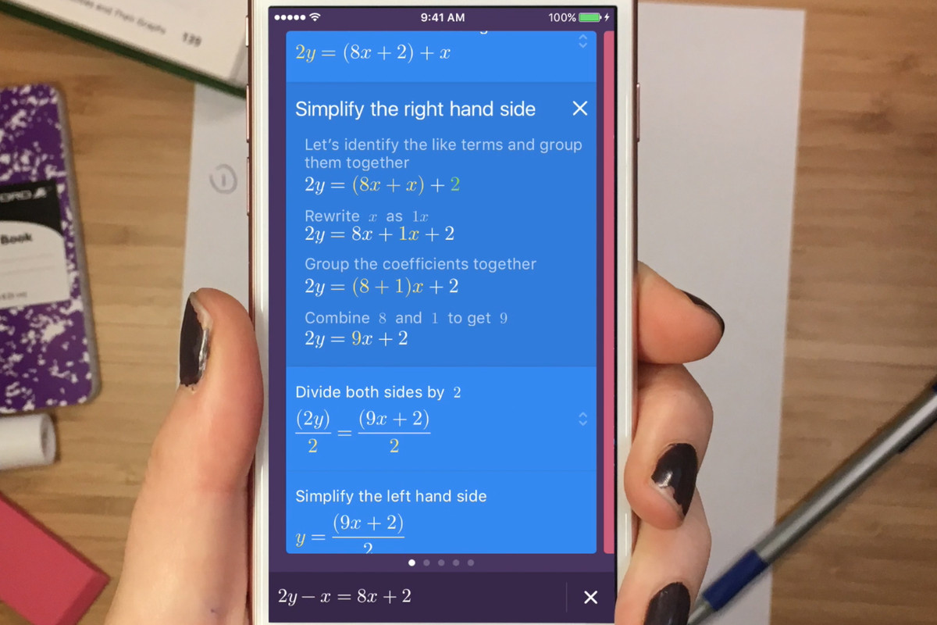

Slide 27
Online Step-by-Step Problem Solvers
https://www.youtube.com/watch?v=vZ1tQZ8glXg&feature=youtu.be
https://www.youtube.com/watch?v=aIlm8FKCZYQ
https://vimeo.com/109405701

Slide 28
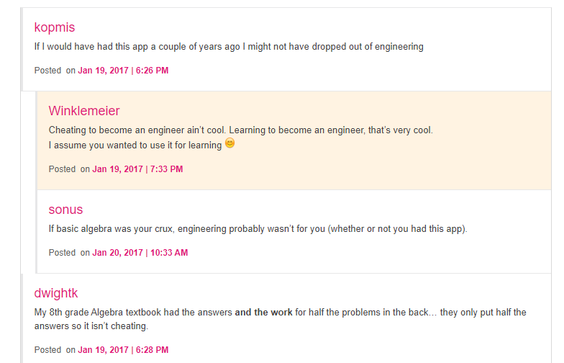
Social media spreads the word!

Slide 29
Online Step-by-Step Problem Solvers
Mathway: https://www.mathway.com
Quickmath: https://quickmath.com/
Symbolab: https://www.symbolab.com/solver

Slide 30
pros and cons
Step by step online calculators
Pros | Cons
save a whole lot of time enhance the technical knowledge can be more accurate help with visualization | aid a lot in cheating can be costly result in dependence give a false sense of confidence

Slide 31
Discussion
RooMath Newsletter
“When I found out about Maple and was given access
to a DEC VAXStation in the 1980's I found my teaching to be
liberated because we could go way beyond the manipulations
by hand and those implied limitations as the machine freed up
the tedium and enabled more discovery, the doing of more
meaningful and realistic problems, and the opening to both
higher level thinking and more complex problems.”
Brian Winkel, Director of SIMIODE
Professor Emeritus of Mathematics

